Slide 1
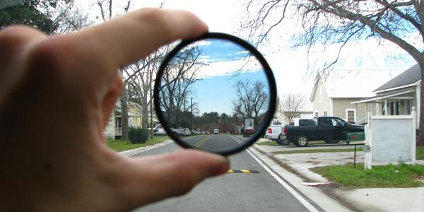


Computational vision: Linear filters
Class 2: Computational Vision
2021-2022

Slide 2
Outline
Digital images:
• Spatial and photometric resolution
• Histogram
• Image contrast enhancement
• Linear filters
• Examples: smoothing filters
• Convolution
• Gaussian filter

Slide 3

Image Formation
Slide credit: Derek Hoiem

Slide 4
Digital camera
The image I(x,y) measures how much light is captured
at pixel (x,y): INTENSITY or BRIGHTNESS.
• Proportional to the number of photons captured at the
sensor element (CCD, CMOS, ..) in a time interval.
4
Slide by Steve Seitz

Slide 5
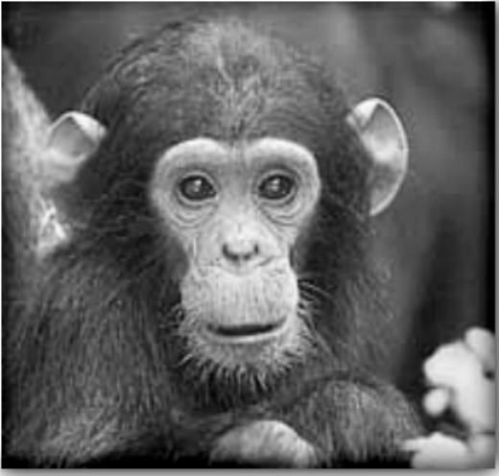
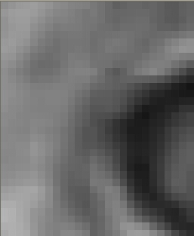
Digital images
Think of images as matrices taken from a sensor array.
K. Grauman

Slide 6
Digital images
Different kinds of images:
•Natural images
• Other modalities:
• X-rays, MRI…
• Light Microscopy, Electron
Microscopy

Slide 7
Digital images
j=0 i=0 width
520
500
height
Intensities for an 8-bit
digital image: [0,255]
im[176,201] has value 164
K. Grauman

Slide 8

Digital images
Sample the 2D space on a regular grid
Quantize each sample (round to nearest integer)
2D
Adapted from S. Seitz

Slide 9
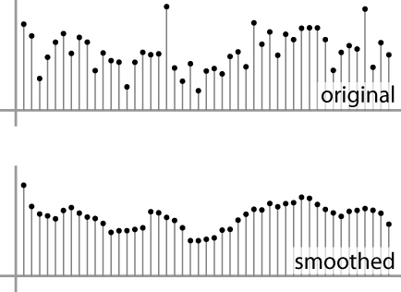
Digital images
Image is represented as a matrix of integer values.
2D
1D
Adapted from S. Seitz

Slide 10
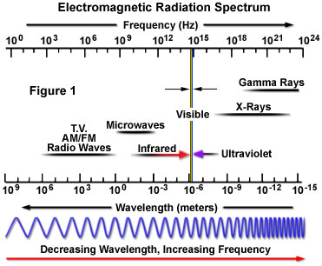
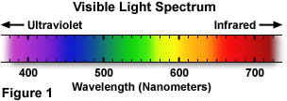
How do we obtain color images?
Light is an energy source that carries coded information about the world, which can be read from a distance through the images!
A typical human eye will respond to wavelengths from about 380 to 750 nm.
In order to get a full colour image, most sensors use filtering to look at the light in its three primary colours (Red, Green, Blue).
Once the camera records all three colours, it combines them to create the full spectrum.

Slide 11
Images in Skimage
Images can be grey-value (1 channel) or color images (3 channels)
Suppose we have an NxM RGB image called “im”
im[0,0,0] = top-left pixel value in R-channel
im[y, x, 2] = y pixels down, x pixels to right in the B-channel
im[N-1, M-1, 1] = bottom-right pixel in the G-channel
column
row
R
0.92 | 0.93 | 0.94 | 0.97 | 0.62 | 0.37 | 0.85 | 0.97 | 0.93 | 0.92 | 0.99
0.95 | 0.89 | 0.82 | 0.89 | 0.56 | 0.31 | 0.75 | 0.92 | 0.81 | 0.95 | 0.91
0.89 | 0.72 | 0.51 | 0.55 | 0.51 | 0.42 | 0.57 | 0.41 | 0.49 | 0.91 | 0.92
0.96 | 0.95 | 0.88 | 0.94 | 0.56 | 0.46 | 0.91 | 0.87 | 0.90 | 0.97 | 0.95
0.71 | 0.81 | 0.81 | 0.87 | 0.57 | 0.37 | 0.80 | 0.88 | 0.89 | 0.79 | 0.85
0.49 | 0.62 | 0.60 | 0.58 | 0.50 | 0.60 | 0.58 | 0.50 | 0.61 | 0.45 | 0.33
0.86 | 0.84 | 0.74 | 0.58 | 0.51 | 0.39 | 0.73 | 0.92 | 0.91 | 0.49 | 0.74
0.96 | 0.67 | 0.54 | 0.85 | 0.48 | 0.37 | 0.88 | 0.90 | 0.94 | 0.82 | 0.93
0.69 | 0.49 | 0.56 | 0.66 | 0.43 | 0.42 | 0.77 | 0.73 | 0.71 | 0.90 | 0.99
0.79 | 0.73 | 0.90 | 0.67 | 0.33 | 0.61 | 0.69 | 0.79 | 0.73 | 0.93 | 0.97
0.91 | 0.94 | 0.89 | 0.49 | 0.41 | 0.78 | 0.78 | 0.77 | 0.89 | 0.99 | 0.93
G
0.92 | 0.93 | 0.94 | 0.97 | 0.62 | 0.37 | 0.85 | 0.97 | 0.93 | 0.92 | 0.99
0.95 | 0.89 | 0.82 | 0.89 | 0.56 | 0.31 | 0.75 | 0.92 | 0.81 | 0.95 | 0.91
0.89 | 0.72 | 0.51 | 0.55 | 0.51 | 0.42 | 0.57 | 0.41 | 0.49 | 0.91 | 0.92
0.96 | 0.95 | 0.88 | 0.94 | 0.56 | 0.46 | 0.91 | 0.87 | 0.90 | 0.97 | 0.95
0.71 | 0.81 | 0.81 | 0.87 | 0.57 | 0.37 | 0.80 | 0.88 | 0.89 | 0.79 | 0.85
0.49 | 0.62 | 0.60 | 0.58 | 0.50 | 0.60 | 0.58 | 0.50 | 0.61 | 0.45 | 0.33
0.86 | 0.84 | 0.74 | 0.58 | 0.51 | 0.39 | 0.73 | 0.92 | 0.91 | 0.49 | 0.74
0.96 | 0.67 | 0.54 | 0.85 | 0.48 | 0.37 | 0.88 | 0.90 | 0.94 | 0.82 | 0.93
0.69 | 0.49 | 0.56 | 0.66 | 0.43 | 0.42 | 0.77 | 0.73 | 0.71 | 0.90 | 0.99
0.79 | 0.73 | 0.90 | 0.67 | 0.33 | 0.61 | 0.69 | 0.79 | 0.73 | 0.93 | 0.97
0.91 | 0.94 | 0.89 | 0.49 | 0.41 | 0.78 | 0.78 | 0.77 | 0.89 | 0.99 | 0.93
B
0.92 | 0.93 | 0.94 | 0.97 | 0.62 | 0.37 | 0.85 | 0.97 | 0.93 | 0.92 | 0.99
0.95 | 0.89 | 0.82 | 0.89 | 0.56 | 0.31 | 0.75 | 0.92 | 0.81 | 0.95 | 0.91
0.89 | 0.72 | 0.51 | 0.55 | 0.51 | 0.42 | 0.57 | 0.41 | 0.49 | 0.91 | 0.92
0.96 | 0.95 | 0.88 | 0.94 | 0.56 | 0.46 | 0.91 | 0.87 | 0.90 | 0.97 | 0.95
0.71 | 0.81 | 0.81 | 0.87 | 0.57 | 0.37 | 0.80 | 0.88 | 0.89 | 0.79 | 0.85
0.49 | 0.62 | 0.60 | 0.58 | 0.50 | 0.60 | 0.58 | 0.50 | 0.61 | 0.45 | 0.33
0.86 | 0.84 | 0.74 | 0.58 | 0.51 | 0.39 | 0.73 | 0.92 | 0.91 | 0.49 | 0.74
0.96 | 0.67 | 0.54 | 0.85 | 0.48 | 0.37 | 0.88 | 0.90 | 0.94 | 0.82 | 0.93
0.69 | 0.49 | 0.56 | 0.66 | 0.43 | 0.42 | 0.77 | 0.73 | 0.71 | 0.90 | 0.99
0.79 | 0.73 | 0.90 | 0.67 | 0.33 | 0.61 | 0.69 | 0.79 | 0.73 | 0.93 | 0.97
0.91 | 0.94 | 0.89 | 0.49 | 0.41 | 0.78 | 0.78 | 0.77 | 0.89 | 0.99 | 0.93
Slide credit: Derek Hoiem

Slide 12
Color images, RGB color space
R G B
Why are the chairs tops appearing in black in two of the channels?
What are the values of a white pixel in the color image?

Slide 13
Today
What is an image?
Types, color vs gray level
How to measure the quality of an image?
Spatial and photometric resolution
Histogram and image contrast enhancement
How to process by a linear filter
Examples: smoothing filters
Convolution / correlation
Mean and median filters
Linear filters with Gaussians

Slide 14
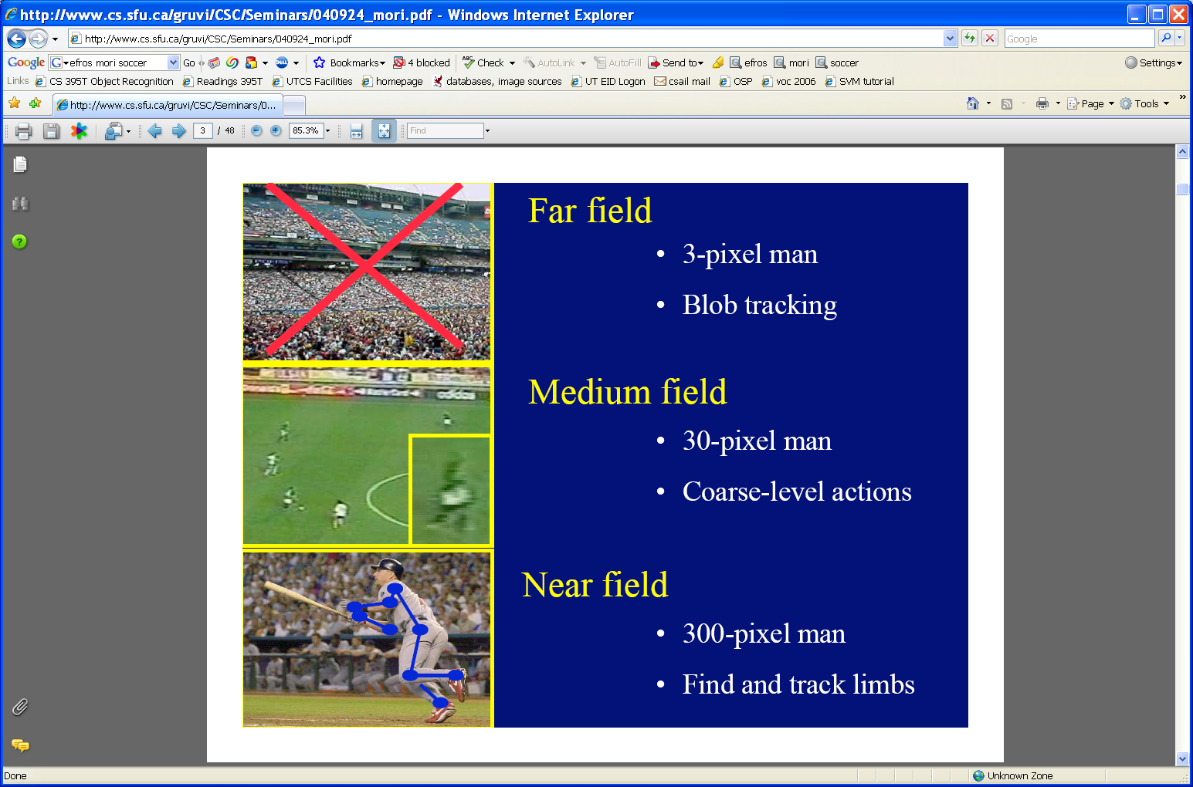
Spatial resolution
Sensor resolution: size of real world scene element that images to a single pixel
Image resolution: number of pixels
[fig from Mori et al]
It influences what analysis is feasible, it affects best representation choice.

Slide 15
Image Magnification
rescale() in
scikit-image

Slide 16
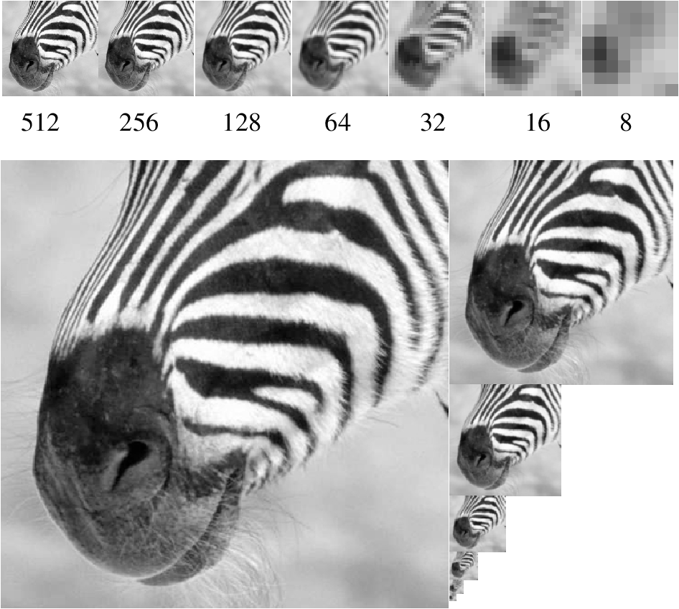
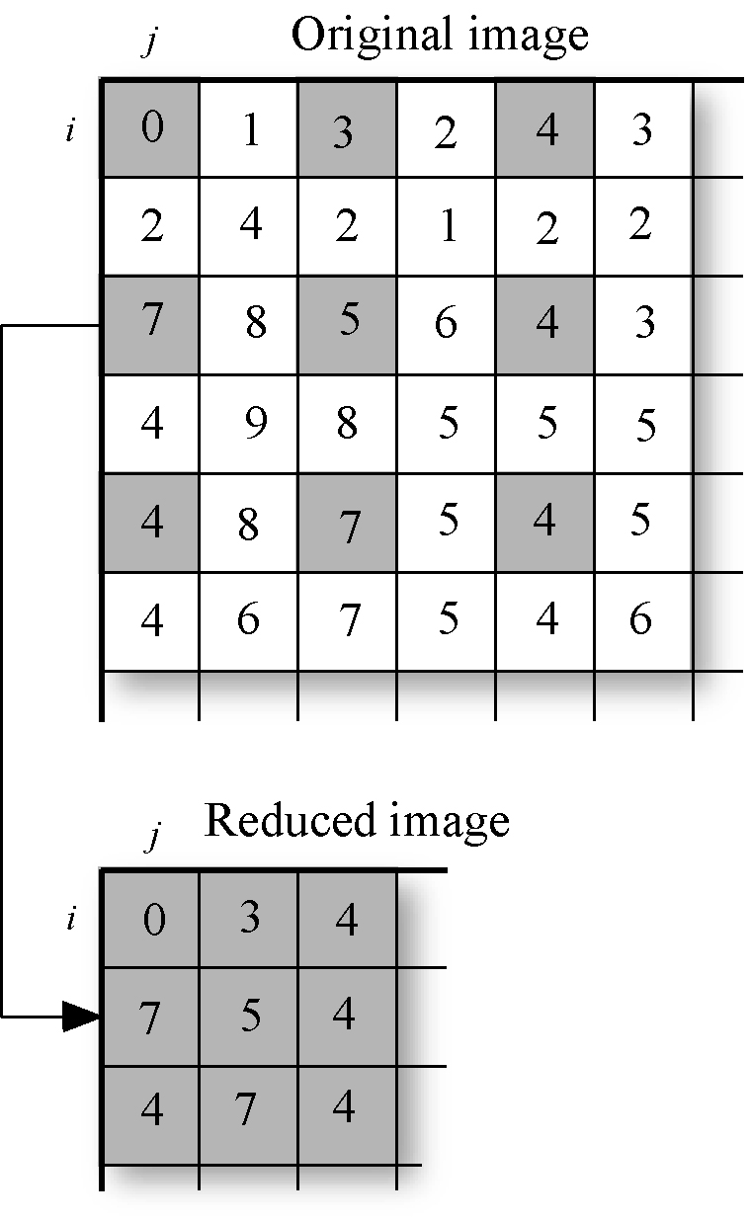
Image reduction

Slide 17
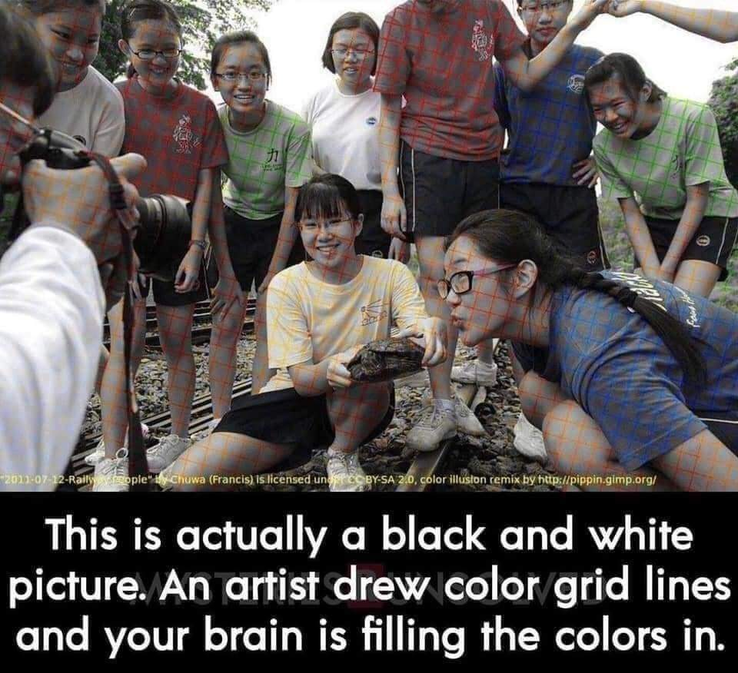

Slide 19
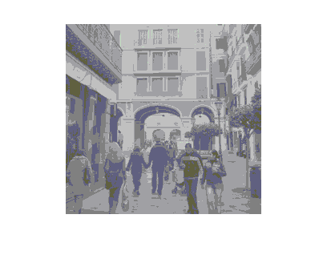
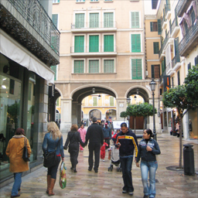
Photometric resolution
Given an image of type uint8, how many grey levels we can have at most?
A histogram of an image represents the frequencies of the image gray levels.
Does it depend on the spatial distribution?
Can it be considered as a measure of image quality?
The number of different grey levels (different pixel values in each color channel) determines the photometric resolution of the image.

Slide 20
Histogram
mm=np.zeros((256, 256,3) dtype=np.uint8)
-> Creates an image of what color?
• Given an image of type uint8, how many grey levels we can have
at most?
• We can change the number of bins of the histogram:

Slide 21
Histogram
How will the histogram of the right image look?
Histogram of 16 bins

Slide 22
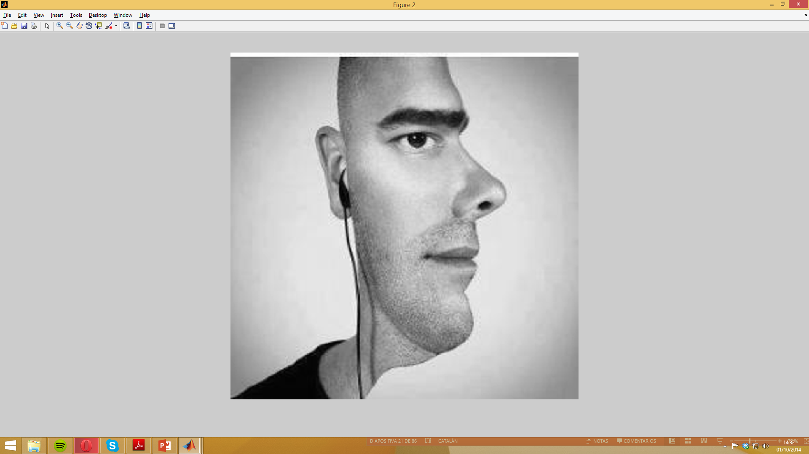
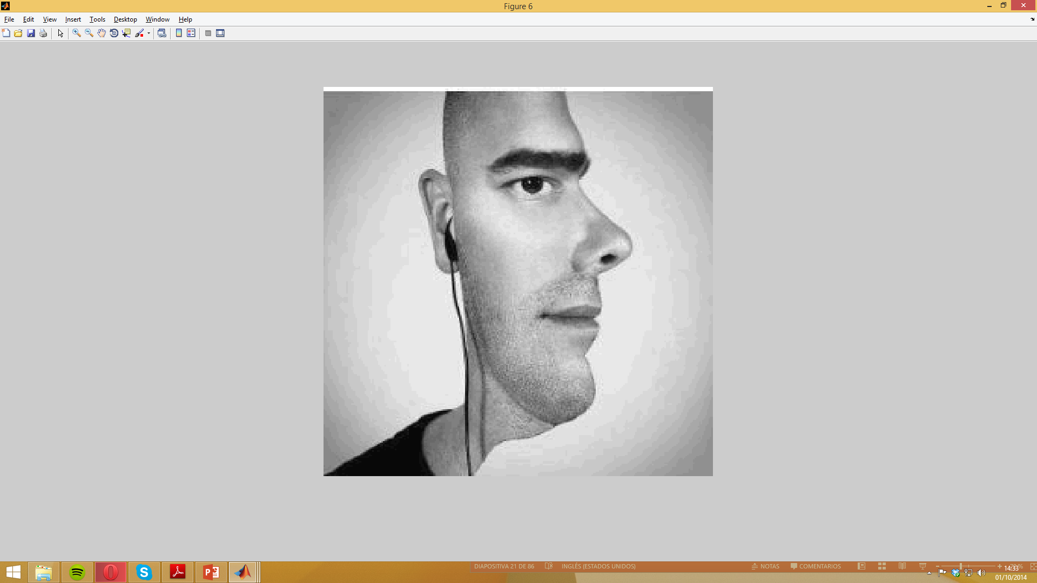
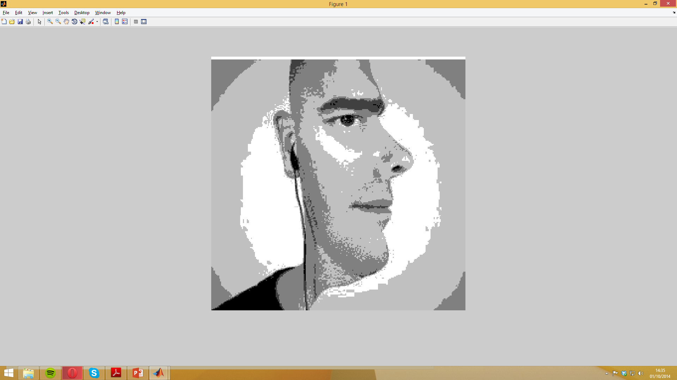
Histogram: How should the histograms look?

Slide 23
Histogram manipulation for image contrast enhancement
•Minimum-maximum contrast stretch
• Percentage linear contrast stretch

Slide 24
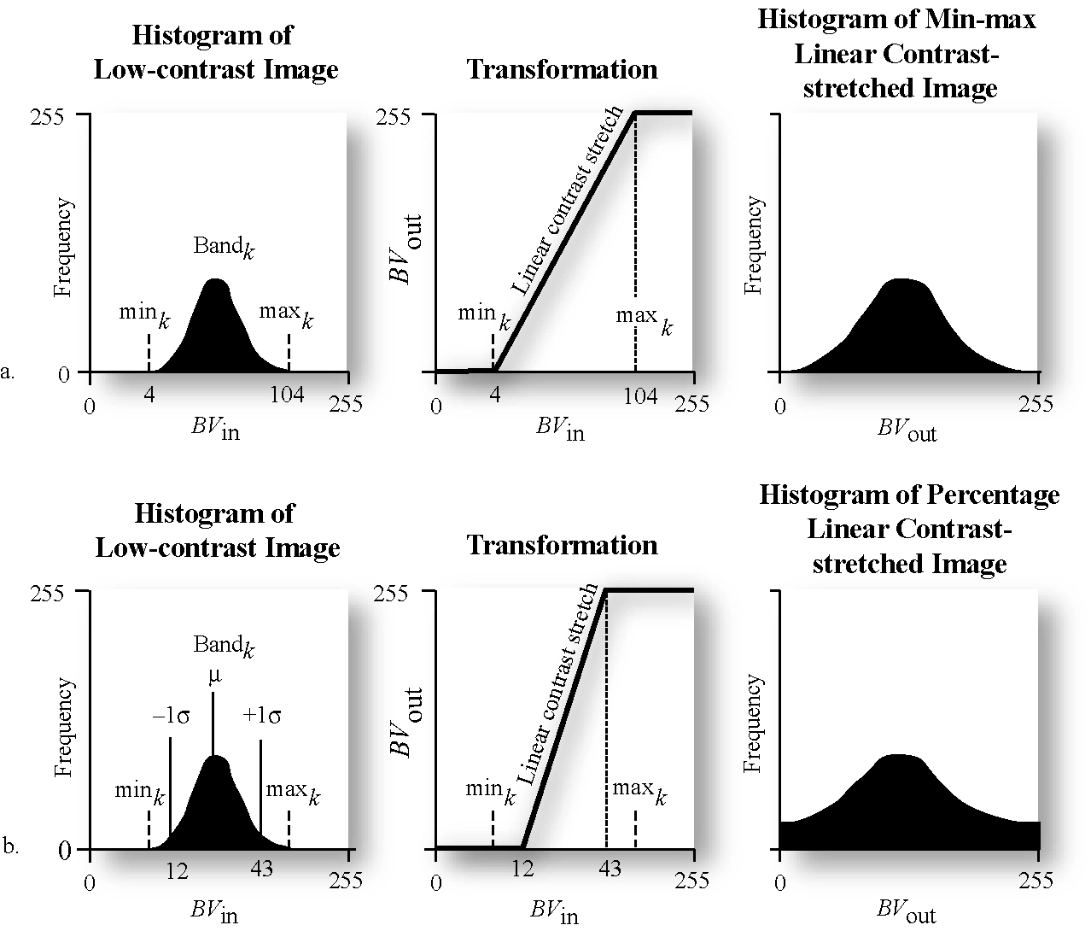
Histogram manipulation for contrast enhancement
Multiply the image to augment its contrast:
where:
- BV_{in} is the original input brightness value (i.e. the original image)
- quant_{k} is the range of the brightness values that can be displayed on the CRT (eg 255),
min_{k} is the minimum value in the image,
max_{k} is the maximum value in the image, and
BV_{out} is the output brightness value.

Slide 25
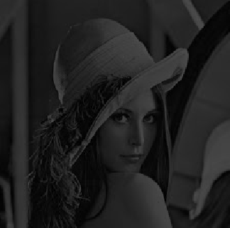
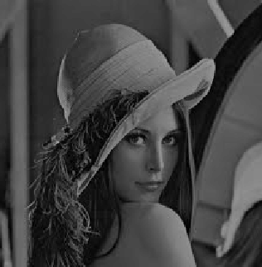
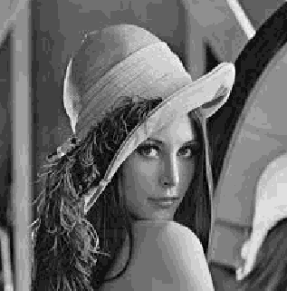
Histogram manipulation for contrast enhancement
Did we augment the photometric quality really?

Slide 26
Today
What is an image?
Types, color vs gray level
How to measure the quality of an image?
Spatial and photometric resolution
Histogram and image contrast enhancement
How to process by a linear filter
Examples: smoothing filters
Convolution / correlation
Mean and median filters
Linear filters with Gaussians

Slide 27
Image filtering
0.92 | 0.93 | 0.94 | 0.97 | 0.62 | 0.37 | 0.85 | 0.97 | 0.93 | 0.92 | 0.99
0.95 | 0.89 | 0.82 | 0.89 | 0.56 | 0.31 | 0.75 | 0.92 | 0.81 | 0.95 | 0.91
0.89 | 0.72 | 0.51 | 0.55 | 0.51 | 0.42 | 0.57 | 0.41 | 0.49 | 0.91 | 0.92
0.96 | 0.95 | 0.88 | 0.94 | 0.56 | 0.46 | 0.91 | 0.87 | 0.90 | 0.97 | 0.95
0.71 | 0.81 | 0.81 | 0.87 | 0.57 | 0.37 | 0.80 | 0.88 | 0.89 | 0.79 | 0.85
0.49 | 0.62 | 0.60 | 0.58 | 0.50 | 0.60 | 0.58 | 0.50 | 0.61 | 0.45 | 0.33
0.86 | 0.84 | 0.74 | 0.58 | 0.51 | 0.39 | 0.73 | 0.92 | 0.91 | 0.49 | 0.74
0.96 | 0.67 | 0.54 | 0.85 | 0.48 | 0.37 | 0.88 | 0.90 | 0.94 | 0.82 | 0.93
0.69 | 0.49 | 0.56 | 0.66 | 0.43 | 0.42 | 0.77 | 0.73 | 0.71 | 0.90 | 0.99
0.79 | 0.73 | 0.90 | 0.67 | 0.33 | 0.61 | 0.69 | 0.79 | 0.73 | 0.93 | 0.97
0.91 | 0.94 | 0.89 | 0.49 | 0.41 | 0.78 | 0.78 | 0.77 | 0.89 | 0.99 | 0.93
Linear Filtering: Compute a function of the local neighborhood at each pixel in the image
Function specified by a “filter” or mask saying how to combine values from neighbors.
Uses of filtering:
Soft blur, smoothing
Enhance an image (remove noise, denoise, etc)
Extract information (Sharpen or accentuate details (texture, edges, etc)
Detect patterns (feature detection and matching, template matching)
Adapted from Derek Hoiem

Slide 28
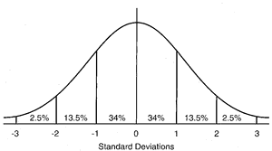
Common types of noise
Salt and pepper noise: random occurrences of black and white pixels
Impulse noise: random occurrences of white pixels
Gaussian noise: variations in intensity drawn from a Gaussian normal distribution
Source: S. Seitz

Slide 29
Lecture videos
Lesson 2: 2A-L1 Images as Functions Part 1
Until 9 - Compute Image Size
• 27 - Common Types of Noise
• 32 - Effect of Sigma on Gaussian Noise
• 36 - Adding Noise
From Introduction to Computer Vision:
https://www.udacity.com/course/introduction-to-computer-vision--ud810

Slide 30
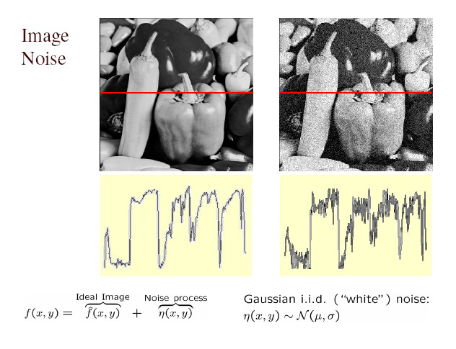
Gaussian noise
What is the impact of sigma (var)?
Fig: M. Hebert

Slide 31
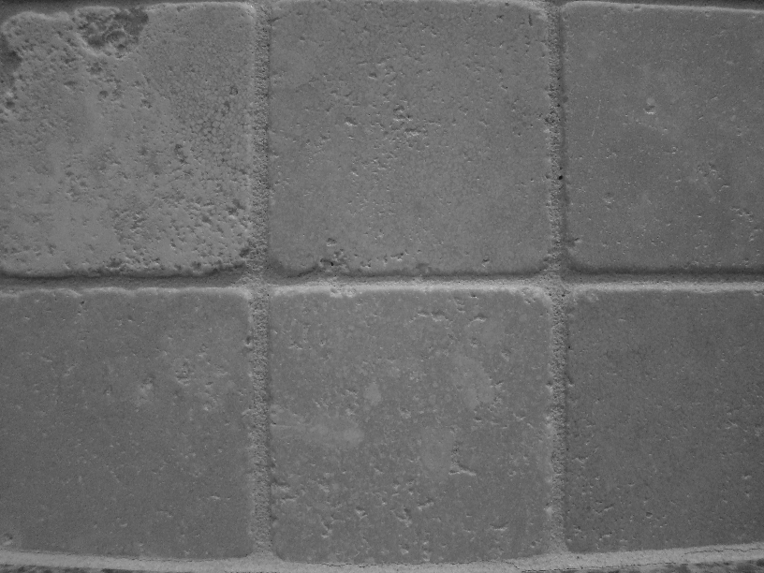
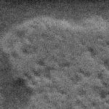
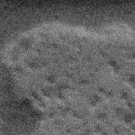

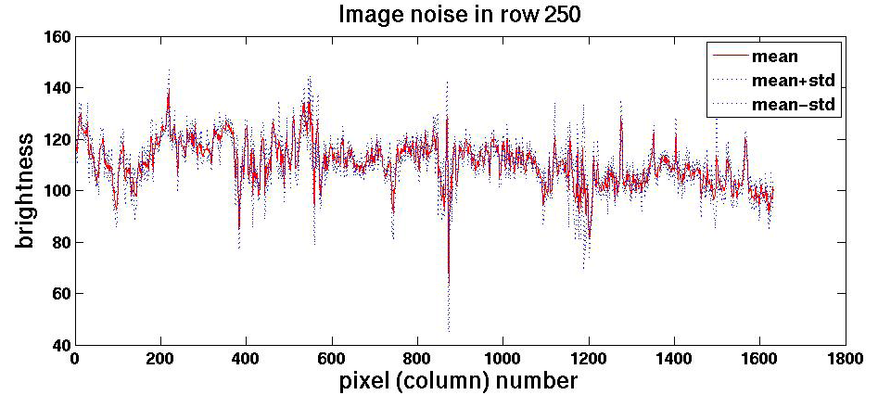
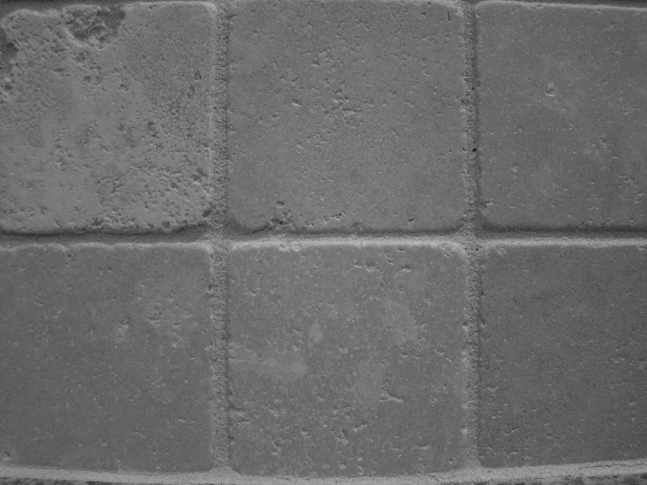
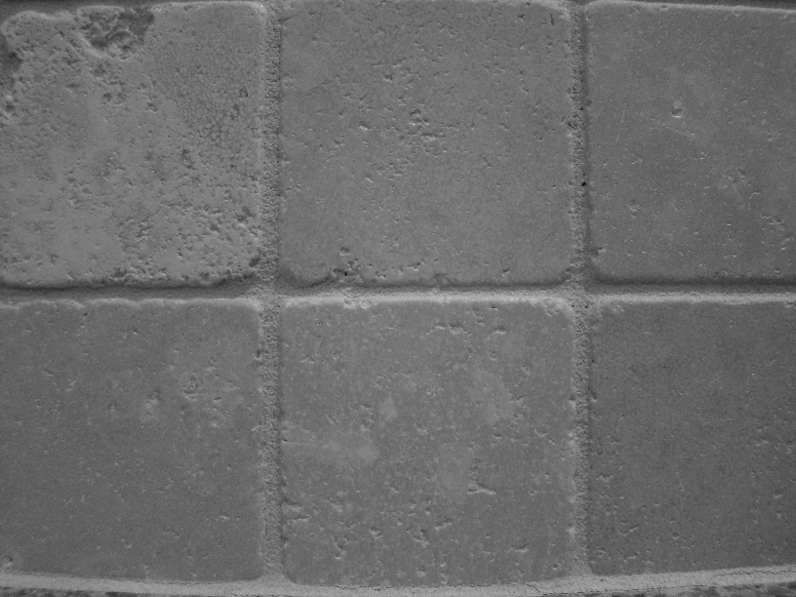


Motivation: noise reduction
Even multiple images of the same static scene will not be identical.

Slide 32
Motivation: noise reduction
Even multiple images of the same static scene will not be identical.
How could we reduce the noise, i.e., give an estimate of the true intensities?
Take the average of the grey values per pixel.
What if there’s only one image?

Slide 33
First attempt at a solution
Let’s replace each pixel with an average of all the values in its neighborhood
Assumptions:
Expect pixels to be like their neighbors
Expect noise processes to be independent from pixel to pixel

Slide 34
Remember: an image is a matrix & topographic map

Slide 35
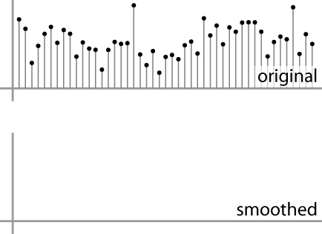
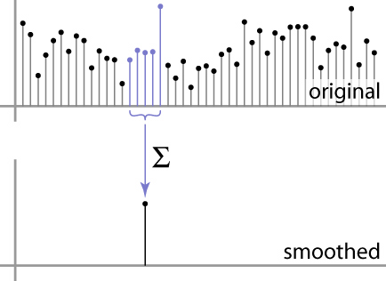
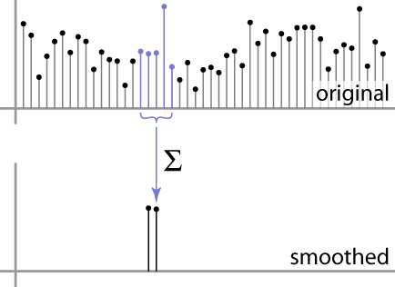
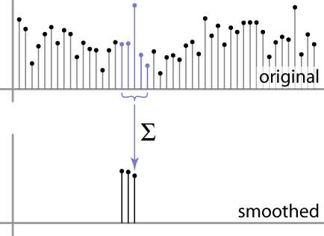
First attempt at a solution
Let’s replace each pixel with an average of all the values in its neighborhood
Moving average in 1D:
Source: S. Marschner

Slide 36
First attempt at a solution
What is the average value?
(F[i-2]+F[i-1]+F[i]+F[i+1]+ F[i+2])/5
For each pixel i, multiply its neighbourhood by a mask:
[1,1,1,1,1]*1/5= [1/5,1/5,1/5,1/5,1/5,1/5]
Definition: Convolution
[1,1,1,1,1]*1/5
+
Source: S. Marschner

Slide 37
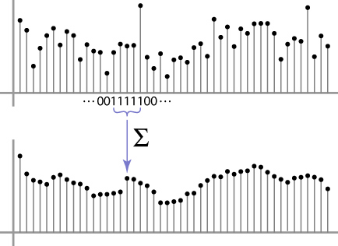
Weighted Moving Average – Mean filter
Weights [1, 1, 1, 1, 1] / 5
Why are we dividing by 5?
Can we add weights to our moving average? Why?
Source: S. Marschner

Slide 38

Weighted Moving Average
Non-uniform weights [1, 4, 6, 4, 1] / 16
What is the difference with the previous one?
Source: S. Marschner

Slide 39
Weighted Moving Average
Non-uniform weights [1, 4, 6, 4, 1] / 16
What is the difference with the previous one?
Source: S. Marschner

Slide 40
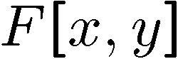
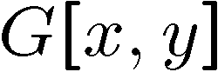
Moving Average in 2D
0 | 0 | 0 | 0 | 0 | 0 | 0 | 0 | 0 | 0
0 | 0 | 0 | 0 | 0 | 0 | 0 | 0 | 0 | 0
0 | 0 | 0 | 90 | 90 | 90 | 90 | 90 | 0 | 0
0 | 0 | 0 | 90 | 90 | 90 | 90 | 90 | 0 | 0
0 | 0 | 0 | 90 | 90 | 90 | 90 | 90 | 0 | 0
0 | 0 | 0 | 90 | 0 | 90 | 90 | 90 | 0 | 0
0 | 0 | 0 | 90 | 90 | 90 | 90 | 90 | 0 | 0
0 | 0 | 0 | 0 | 0 | 0 | 0 | 0 | 0 | 0
0 | 0 | 90 | 0 | 0 | 0 | 0 | 0 | 0 | 0
0 | 0 | 0 | 0 | 0 | 0 | 0 | 0 | 0 | 0
 | 0
0 | 0 | 0 | 0 | 0 | 0 | 0 | 0 | 0 | 0
0 | 0 | 0 | 0 | 0 | 0 | 0 | 0 | 0 | 0
0 | 0 | 0 | 90 | 90 | 90 | 90 | 90 | 0 | 0
0 | 0 | 0 | 90 | 90 | 90 | 90 | 90 | 0 | 0
0 | 0 | 0 | 90 | 90 | 90 | 90 | 90 | 0 | 0
0 | 0 | 0 | 90 | 0 | 90 | 90 | 90 | 0 | 0
0 | 0 | 0 | 90 | 90 | 90 | 90 | 90 | 0 | 0
0 | 0 | 0 | 0 | 0 | 0 | 0 | 0 | 0 | 0
0 | 0 | 90 | 0 | 0 | 0 | 0 | 0 | 0 | 0
0 | 0 | 0 | 0 | 0 | 0 | 0 | 0 | 0 | 0
Source: S. Seitz

Slide 41
Moving Average in 2D
0 | 0 | 0 | 0 | 0 | 0 | 0 | 0 | 0 | 0
0 | 0 | 0 | 0 | 0 | 0 | 0 | 0 | 0 | 0
0 | 0 | 0 | 90 | 90 | 90 | 90 | 90 | 0 | 0
0 | 0 | 0 | 90 | 90 | 90 | 90 | 90 | 0 | 0
0 | 0 | 0 | 90 | 90 | 90 | 90 | 90 | 0 | 0
0 | 0 | 0 | 90 | 0 | 90 | 90 | 90 | 0 | 0
0 | 0 | 0 | 90 | 90 | 90 | 90 | 90 | 0 | 0
0 | 0 | 0 | 0 | 0 | 0 | 0 | 0 | 0 | 0
0 | 0 | 90 | 0 | 0 | 0 | 0 | 0 | 0 | 0
0 | 0 | 0 | 0 | 0 | 0 | 0 | 0 | 0 | 0
 | 0 | 10
0 | 0 | 0 | 0 | 0 | 0 | 0 | 0 | 0 | 0
0 | 0 | 0 | 0 | 0 | 0 | 0 | 0 | 0 | 0
0 | 0 | 0 | 90 | 90 | 90 | 90 | 90 | 0 | 0
0 | 0 | 0 | 90 | 90 | 90 | 90 | 90 | 0 | 0
0 | 0 | 0 | 90 | 90 | 90 | 90 | 90 | 0 | 0
0 | 0 | 0 | 90 | 0 | 90 | 90 | 90 | 0 | 0
0 | 0 | 0 | 90 | 90 | 90 | 90 | 90 | 0 | 0
0 | 0 | 0 | 0 | 0 | 0 | 0 | 0 | 0 | 0
0 | 0 | 90 | 0 | 0 | 0 | 0 | 0 | 0 | 0
0 | 0 | 0 | 0 | 0 | 0 | 0 | 0 | 0 | 0
Source: S. Seitz

Slide 42
Moving Average in 2D
0 | 0 | 0 | 0 | 0 | 0 | 0 | 0 | 0 | 0
0 | 0 | 0 | 0 | 0 | 0 | 0 | 0 | 0 | 0
0 | 0 | 0 | 90 | 90 | 90 | 90 | 90 | 0 | 0
0 | 0 | 0 | 90 | 90 | 90 | 90 | 90 | 0 | 0
0 | 0 | 0 | 90 | 90 | 90 | 90 | 90 | 0 | 0
0 | 0 | 0 | 90 | 0 | 90 | 90 | 90 | 0 | 0
0 | 0 | 0 | 90 | 90 | 90 | 90 | 90 | 0 | 0
0 | 0 | 0 | 0 | 0 | 0 | 0 | 0 | 0 | 0
0 | 0 | 90 | 0 | 0 | 0 | 0 | 0 | 0 | 0
0 | 0 | 0 | 0 | 0 | 0 | 0 | 0 | 0 | 0
 | 0 | 10 | 20
0 | 0 | 0 | 0 | 0 | 0 | 0 | 0 | 0 | 0
0 | 0 | 0 | 0 | 0 | 0 | 0 | 0 | 0 | 0
0 | 0 | 0 | 90 | 90 | 90 | 90 | 90 | 0 | 0
0 | 0 | 0 | 90 | 90 | 90 | 90 | 90 | 0 | 0
0 | 0 | 0 | 90 | 90 | 90 | 90 | 90 | 0 | 0
0 | 0 | 0 | 90 | 0 | 90 | 90 | 90 | 0 | 0
0 | 0 | 0 | 90 | 90 | 90 | 90 | 90 | 0 | 0
0 | 0 | 0 | 0 | 0 | 0 | 0 | 0 | 0 | 0
0 | 0 | 90 | 0 | 0 | 0 | 0 | 0 | 0 | 0
0 | 0 | 0 | 0 | 0 | 0 | 0 | 0 | 0 | 0
Source: S. Seitz

Slide 43
Moving Average In 2D
0 | 0 | 0 | 0 | 0 | 0 | 0 | 0 | 0 | 0
0 | 0 | 0 | 0 | 0 | 0 | 0 | 0 | 0 | 0
0 | 0 | 0 | 90 | 90 | 90 | 90 | 90 | 0 | 0
0 | 0 | 0 | 90 | 90 | 90 | 90 | 90 | 0 | 0
0 | 0 | 0 | 90 | 90 | 90 | 90 | 90 | 0 | 0
0 | 0 | 0 | 90 | 0 | 90 | 90 | 90 | 0 | 0
0 | 0 | 0 | 90 | 90 | 90 | 90 | 90 | 0 | 0
0 | 0 | 0 | 0 | 0 | 0 | 0 | 0 | 0 | 0
0 | 0 | 90 | 0 | 0 | 0 | 0 | 0 | 0 | 0
0 | 0 | 0 | 0 | 0 | 0 | 0 | 0 | 0 | 0
 | 0 | 10 | 20 | 30
0 | 0 | 0 | 0 | 0 | 0 | 0 | 0 | 0 | 0
0 | 0 | 0 | 0 | 0 | 0 | 0 | 0 | 0 | 0
0 | 0 | 0 | 90 | 90 | 90 | 90 | 90 | 0 | 0
0 | 0 | 0 | 90 | 90 | 90 | 90 | 90 | 0 | 0
0 | 0 | 0 | 90 | 90 | 90 | 90 | 90 | 0 | 0
0 | 0 | 0 | 90 | 0 | 90 | 90 | 90 | 0 | 0
0 | 0 | 0 | 90 | 90 | 90 | 90 | 90 | 0 | 0
0 | 0 | 0 | 0 | 0 | 0 | 0 | 0 | 0 | 0
0 | 0 | 90 | 0 | 0 | 0 | 0 | 0 | 0 | 0
0 | 0 | 0 | 0 | 0 | 0 | 0 | 0 | 0 | 0
Source: S. Seitz

Slide 44
Moving Average in 2D
0 | 0 | 0 | 0 | 0 | 0 | 0 | 0 | 0 | 0
0 | 0 | 0 | 0 | 0 | 0 | 0 | 0 | 0 | 0
0 | 0 | 0 | 90 | 90 | 90 | 90 | 90 | 0 | 0
0 | 0 | 0 | 90 | 90 | 90 | 90 | 90 | 0 | 0
0 | 0 | 0 | 90 | 90 | 90 | 90 | 90 | 0 | 0
0 | 0 | 0 | 90 | 0 | 90 | 90 | 90 | 0 | 0
0 | 0 | 0 | 90 | 90 | 90 | 90 | 90 | 0 | 0
0 | 0 | 0 | 0 | 0 | 0 | 0 | 0 | 0 | 0
0 | 0 | 90 | 0 | 0 | 0 | 0 | 0 | 0 | 0
0 | 0 | 0 | 0 | 0 | 0 | 0 | 0 | 0 | 0
 | 0 | 10 | 20 | 30 | 30
Source: S. Seitz

Slide 45
Moving Average in 2D
0 | 0 | 0 | 0 | 0 | 0 | 0 | 0 | 0 | 0
0 | 0 | 0 | 0 | 0 | 0 | 0 | 0 | 0 | 0
0 | 0 | 0 | 90 | 90 | 90 | 90 | 90 | 0 | 0
0 | 0 | 0 | 90 | 90 | 90 | 90 | 90 | 0 | 0
0 | 0 | 0 | 90 | 90 | 90 | 90 | 90 | 0 | 0
0 | 0 | 0 | 90 | 0 | 90 | 90 | 90 | 0 | 0
0 | 0 | 0 | 90 | 90 | 90 | 90 | 90 | 0 | 0
0 | 0 | 0 | 0 | 0 | 0 | 0 | 0 | 0 | 0
0 | 0 | 90 | 0 | 0 | 0 | 0 | 0 | 0 | 0
0 | 0 | 0 | 0 | 0 | 0 | 0 | 0 | 0 | 0
 | 0 | 10 | 20 | 30 | 30 | 30 | 20 | 10
 | 0 | 20 | 40 | 60 | 60 | 60 | 40 | 20
 | 0 | 30 | 60 | 90 | 90 | 90 | 60 | 30
 | 0 | 30 | 50 | 80 | 80 | 90 | 60 | 30
 | 0 | 30 | 50 | 80 | 80 | 90 | 60 | 30
 | 0 | 20 | 30 | 50 | 50 | 60 | 40 | 20
 | 10 | 20 | 30 | 30 | 30 | 30 | 20 | 10
 | 10 | 10 | 10 | 0 | 0 | 0 | 0 | 0
Source: S. Seitz
Notes:
ones, divide by 9

Slide 46
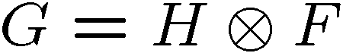
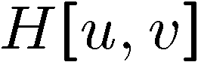
Linear filter
0 | 0 | 0 | 0 | 0 | 0 | 0 | 0 | 0 | 0
0 | 0 | 0 | 0 | 0 | 0 | 0 | 0 | 0 | 0
0 | 0 | 0 | 90 | 90 | 90 | 90 | 90 | 0 | 0
0 | 0 | 0 | 90 | 90 | 90 | 90 | 90 | 0 | 0
0 | 0 | 0 | 90 | 90 | 90 | 90 | 90 | 0 | 0
0 | 0 | 0 | 90 | 0 | 90 | 90 | 90 | 0 | 0
0 | 0 | 0 | 90 | 90 | 90 | 90 | 90 | 0 | 0
0 | 0 | 0 | 0 | 0 | 0 | 0 | 0 | 0 | 0
0 | 0 | 90 | 0 | 0 | 0 | 0 | 0 | 0 | 0
0 | 0 | 0 | 0 | 0 | 0 | 0 | 0 | 0 | 0
a | b | c
d | e | f
g | h | i
“box filter”

Slide 47
Linear filter
Normalization: divide the mask by (a+b+c+d+e+f+g+h+i)
0 | 0 | 0 | 0 | 0 | 0 | 0 | 0 | 0 | 0
0 | 0 | 0 | 0 | 0 | 0 | 0 | 0 | 0 | 0
0 | 0 | 0 | 90 | 90 | 90 | 90 | 90 | 0 | 0
0 | 0 | 0 | 90 | 90 | 90 | 90 | 90 | 0 | 0
0 | 0 | 0 | 90 | 90 | 90 | 90 | 90 | 0 | 0
0 | 0 | 0 | 90 | 0 | 90 | 90 | 90 | 0 | 0
0 | 0 | 0 | 90 | 90 | 90 | 90 | 90 | 0 | 0
0 | 0 | 0 | 0 | 0 | 0 | 0 | 0 | 0 | 0
0 | 0 | 90 | 0 | 0 | 0 | 0 | 0 | 0 | 0
0 | 0 | 0 | 0 | 0 | 0 | 0 | 0 | 0 | 0
 | 0 | 10 | 20 | 30 | 30
a | b | c
d | e | f
g | h | i
“box filter”
*1/(a+b+c+d+e+f+g+h+i)

Slide 48
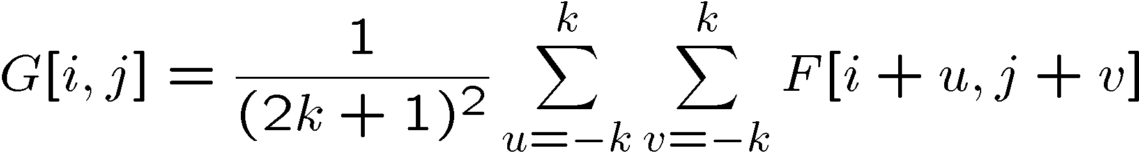
Convolutional filtering
Say the averaging window size is (2k+1) x (2k+1):
Attribute uniform weight to each pixel
Loop over all pixels in neighborhood around image pixel F[i,j]

Slide 49
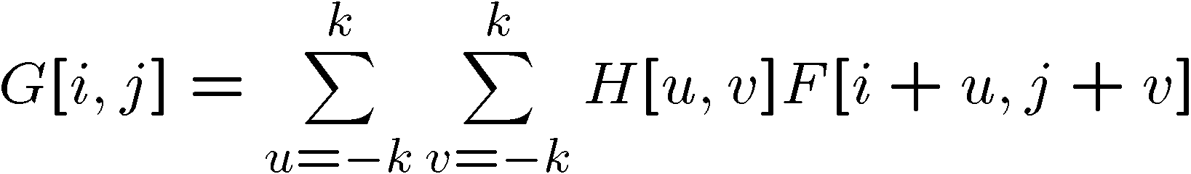
Convolutional filtering
Now generalize to allow different weights depending on neighboring pixel’s relative position:
Non-uniform weights

Slide 50
Convolutional filtering
This is called convolution, denoted as:
Filtering an image: replace each pixel with a linear combination of its neighbors.
The filter “kernel” or “mask” H[u,v] is the prescription for the weights in the linear combination.

Slide 51

Mean filter
What values do belong in the kernel H for the moving average example?
0 | 0 | 0 | 0 | 0 | 0 | 0 | 0 | 0 | 0
0 | 0 | 0 | 0 | 0 | 0 | 0 | 0 | 0 | 0
0 | 0 | 0 | 90 | 90 | 90 | 90 | 90 | 0 | 0
0 | 0 | 0 | 90 | 90 | 90 | 90 | 90 | 0 | 0
0 | 0 | 0 | 90 | 90 | 90 | 90 | 90 | 0 | 0
0 | 0 | 0 | 90 | 0 | 90 | 90 | 90 | 0 | 0
0 | 0 | 0 | 90 | 90 | 90 | 90 | 90 | 0 | 0
0 | 0 | 0 | 0 | 0 | 0 | 0 | 0 | 0 | 0
0 | 0 | 90 | 0 | 0 | 0 | 0 | 0 | 0 | 0
0 | 0 | 0 | 0 | 0 | 0 | 0 | 0 | 0 | 0
 | 0 | 10 | 20 | 30 | 30
1
1
1
1
?
1
1
1
1
1
“box filter”

Slide 52
Mean filter
Normalization: why do we need to divide the mask by 9?
0 | 0 | 0 | 0 | 0 | 0 | 0 | 0 | 0 | 0
0 | 0 | 0 | 0 | 0 | 0 | 0 | 0 | 0 | 0
0 | 0 | 0 | 90 | 90 | 90 | 90 | 90 | 0 | 0
0 | 0 | 0 | 90 | 90 | 90 | 90 | 90 | 0 | 0
0 | 0 | 0 | 90 | 90 | 90 | 90 | 90 | 0 | 0
0 | 0 | 0 | 90 | 0 | 90 | 90 | 90 | 0 | 0
0 | 0 | 0 | 90 | 90 | 90 | 90 | 90 | 0 | 0
0 | 0 | 0 | 0 | 0 | 0 | 0 | 0 | 0 | 0
0 | 0 | 90 | 0 | 0 | 0 | 0 | 0 | 0 | 0
0 | 0 | 0 | 0 | 0 | 0 | 0 | 0 | 0 | 0
 | 0 | 10 | 20 | 30 | 30
1
1
1
1
?
1
1
1
1
1
“box filter”

Slide 53
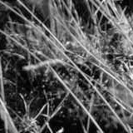
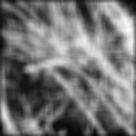
Smoothing by averaging
original
filtered
What is the effect if the filter size was 5 x 5 instead of 3 x 3?

Slide 54
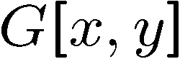
Filtering an impulse signal
What is the result of filtering the impulse signal (image) F with the arbitrary kernel H?
0 | 0 | 0 | 0 | 0 | 0 | 0
0 | 0 | 0 | 0 | 0 | 0 | 0
0 | 0 | 0 | 0 | 0 | 0 | 0
0 | 0 | 0 | 1 | 0 | 0 | 0
0 | 0 | 0 | 0 | 0 | 0 | 0
0 | 0 | 0 | 0 | 0 | 0 | 0
0 | 0 | 0 | 0 | 0 | 0 | 0
a | b | c
d | e | f
g | h | i
?

Slide 55
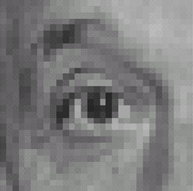
Practice with linear filters
0
0
0
?
0
1
0
0
0
0
Original
Source: D. Lowe

Slide 56
Practice with linear filters
0
0
0
0
1
0
0
0
0
Original
Filtered
(no change)
Source: D. Lowe

Slide 57
Practice with linear filters
0
0
0
?
0
0
1
0
0
0
Original
Source: D. Lowe

Slide 58
Practice with linear filters
0
0
0
0
0
1
0
0
0
Original
Shifted left
by 1 pixel with correlation
Source: D. Lowe

Slide 59
Practice with linear filters
1
1
1
?
1
1
1
1
1
1
Original
Source: D. Lowe

Slide 60
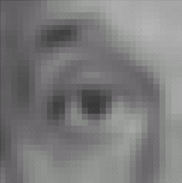
Practice with linear filters
1
1
1
1
1
1
1
1
1
Original
Blur (with a
box filter)
Source: D. Lowe

Slide 61
Practice with linear filters
0
0
0
-
1
1
1
?
0
2
0
1
1
1
0
0
0
1
1
1
Original
Source: D. Lowe

Slide 62
Properties of convolution
Shift invariant:
Operator behaves the same everywhere, i.e. the value of the output depends on the pattern in the image neighborhood, not the position of the neighborhood.
Superposition:
h * (f1 + f2) = (h * f1) + (h * f2)

Slide 63
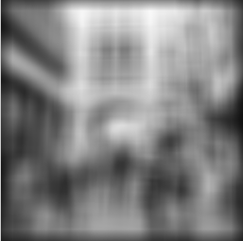
Smoothing with a rectangular filter
=
h[i,j]
f[x,y]
I[x,y]
1,1,1,1,1
1,1,1,1,1
1,1,1,1,1
1,1,1,1,1
1,1,1,1,1
Mask=1/25*
Notes:
63

Slide 64
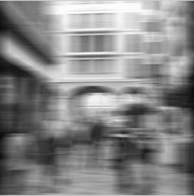
Smoothing with a rectangular filter
=
h[i,j]
I[x,y]
f[x,y]
Mask=
1/5*[1,1,1,1,1]
Notes:
64

Slide 65

Smoothing with a rectangular filter
=
h[i,j]
1,
1,
1,
1,
1
f[x,y]
I[x,y]
Mask=1/5*
Notes:
65

Slide 66
Today
What is an image?
Types, color vs gray level
How to measure the quality of an image?
Spatial and photometric resolution
Histogram and image contrast enhancement
How to process by a linear filter
Examples: smoothing filters
Convolution / correlation
Mean and median filters
Linear filters with Gaussians

Slide 67
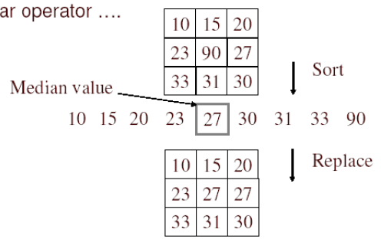
Median filter
What is the behavior of the mean
filter in the impulse noise pixels?
No new pixel values introduced
Removes spikes: good for impulse, salt & pepper noise
Non-linear filter (it can be proved)

Slide 68
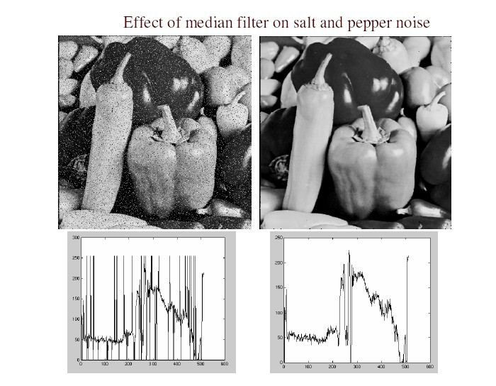
Median filter
Salt and pepper noise
Median filtered
Plots of a row of the image
Source: M. Hebert

Slide 69
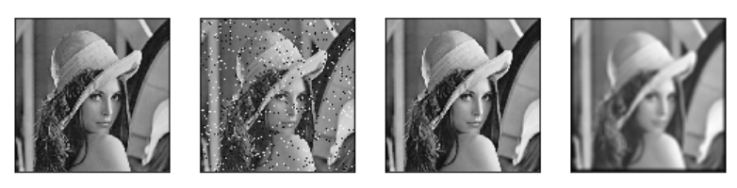
Median filter vs Mean filter
Introduce the captions of the images
Source: M. Hebert

Slide 70
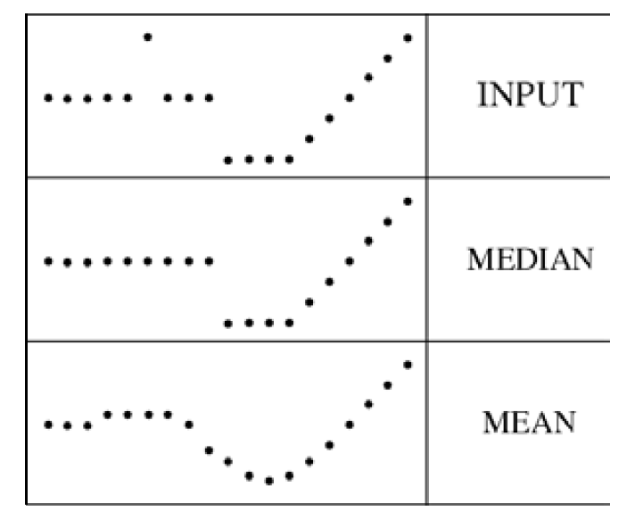
Median filter
Median filter is edge preserving
What would be the result of a mean filter?

Slide 71
Today
What is an image?
Types, color vs gray level
How to measure the quality of an image?
Spatial and photometric resolution
Histogram and image contrast enhancement
How to process by a linear filter
Examples: smoothing filters
Convolution / correlation
Mean and median filters
Linear filters with Gaussians

Slide 72
Weighted Moving Average
Weights [1, 1, 1, 1, 1] / 5
Non-uniform weights [1, 4, 6, 4, 1] / 16
Adding weights to our moving average? Why?
Source: S. Marschner

Slide 73
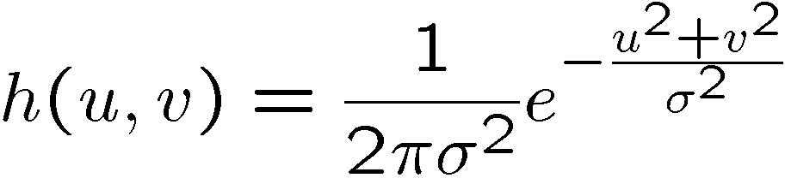


Gaussian filter
What if we want nearest neighboring pixels to have the most influence on the output?
Removes high-frequency components from the image (“low-pass filter”).
This kernel is an approximation of a 2D Gaussian function:
0 | 0 | 0 | 0 | 0 | 0 | 0 | 0 | 0 | 0
0 | 0 | 0 | 0 | 0 | 0 | 0 | 0 | 0 | 0
0 | 0 | 0 | 90 | 90 | 90 | 90 | 90 | 0 | 0
0 | 0 | 0 | 90 | 90 | 90 | 90 | 90 | 0 | 0
0 | 0 | 0 | 90 | 90 | 90 | 90 | 90 | 0 | 0
0 | 0 | 0 | 90 | 0 | 90 | 90 | 90 | 0 | 0
0 | 0 | 0 | 90 | 90 | 90 | 90 | 90 | 0 | 0
0 | 0 | 0 | 0 | 0 | 0 | 0 | 0 | 0 | 0
0 | 0 | 90 | 0 | 0 | 0 | 0 | 0 | 0 | 0
0 | 0 | 0 | 0 | 0 | 0 | 0 | 0 | 0 | 0
1 | 2 | 1
2 | 4 | 2
1 | 2 | 1
Source: S. Seitz

Slide 74

Smoothing with a Gaussian

Slide 75

Gaussian filters
What parameters do matter here?
Size of kernel or mask
Note, Gaussian function has infinite support, but discrete filters use finite kernels
σ = 5 with 10 x 10 kernel
σ = 5 with 30 x 30 kernel

Slide 76




Gaussian filters
What parameters do matter here?
Variance of Gaussian: determines extent of smoothing
σ = 2 with 30 x 30 kernel
σ = 5 with 30 x 30 kernel

Slide 77




Smoothing with a Gaussian filter
Applying a smoothing operation with a Gaussian with sigma=1
Gaussian filter
output

Slide 78



Smoothing with a Gaussian filter
Parameter σ is the “scale” / “width” / “spread” of the Gaussian kernel, and controls the amount of smoothing.
…
Applying Gaussian smothing with different sigma parameters

Slide 79



Local vs global analysis
Dali

Slide 80
Sharpening

Slide 81
Summary
Digital images: resolution, “noise”
Histograms – a tool to visualize the statistical distribution of grey levels of pixels
Linear filters and convolution useful for
Enhancing images (smoothing, removing noise)
Box filter
Impact of scale / width of smoothing filter
Gaussians – how to use analytical functions to control processing scale
Next: convolutions for image Gradient estimation

Slide 82
Properties of smoothing filters
Smoothing
Values positive
Sum to 1 → constant regions same as input
Amount of smoothing proportional to mask size
Remove “high-frequency” components; “low-pass” filter
Test:
Smoothing can improve ………. resolution and quality
Smoothing does not improve ……. resolution
……………. resolution affects the speed of the algorithms
……………. resolution does not affect the speed of the algorithms.

Slide 83
References
Source for slides are from the courses of:
• J. Malik, UBerkeley
• Prof. K. Grauman, UT-Austin
• D. Hoiem
• S. Marschner
• D. Lowe
• S. Seitz
• Some Figures from [Mori et al]

Slide 84
Lecture videos
• Lesson 3: 2A-L2 Filtering
2 - Gaussian Noise
Until - Variance or Standard Deviation
17 - Gaussian Filter Quiz
18 - Keeping the Two Gaussians Straight
From Introduction to Computer Vision:
https://www.udacity.com/course/introduction-to-computer-vision--ud810

